Slide 1
UNDP REGIONAL CONSULTATION
June 23, 2021 – 5:00-6:00pm CAT
Conducted Virtually via Zoom: https://undp.zoom.us/j/89494047689?pwd=dHJVQnFrK2sxTTJlaDZ3VHY2K1VBUT09#success

Slide 2
Presentation Agenda
1 | Introduction to Impact@Africa
2 | Review of 2021 Priorities
3 | Potential Areas of Collaboration with UNDP

Slide 3
01.
Introduction to Impact@Africa
Michael Sudarkasa – Impact@Africa Chair & Africa Business Group CEO

Slide 4
Impact@Africa
The pan-African impact investment ecosystem development
network that brings together all ecosystem players and
provides a strong, unified voice for the advancement
of impact investing on the continent.
Mission
Vision
Foster impact investment ecosystem growth in Africa by serving as a leader and information hub that pilots, promotes and advocates for innovations that solve transactional barriers and builds capacities to strengthen infrastructure.
A robust impact investment ecosystem that delivers for Africa and supports the implementation of Agenda 2063 and the Sustainable Development Goals (SDGs).
Formally Registered as Limited by Guarantee Company in Kenya as Impact Council For Investment In Africa Ltd (“Impact@Africa”) -
In June 2021, the Board Moved to Reincorporate I@A in South Africa and Establish the Secretariat at University of Witwatersrand

Slide 5

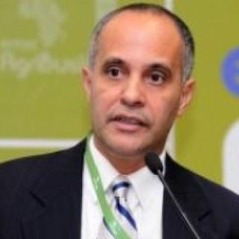


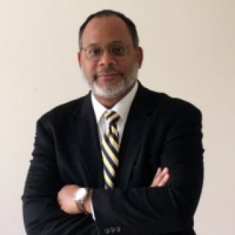

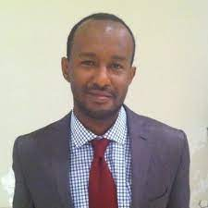

Impact@Africa Board
2021
Michael Sudarkasa
Chair
CEO, Africa Business Group
Tomas Sales
Vice-Chair
UNDP Special Advisor for Private Sector
and SDG Financing
Salma Seedat
CCG & Special Initiatives at BroadReach
David Mueller
SDG Investor Maps Specialist at UNDP SDG Impact
David McClean
Owner and Senior Consultant
at DMA Consulting Group
Tara Collier
Visiting Fellow
Saïd Business School, University of Oxford
Dagmawi Selassie
Programme Officer
IFAD
Lise Birikundavyi
Principal chez Black Innovation Capital

Slide 6
02.
2021Priorities

Slide 7
2021 Priorities & Activities – In Progress
Strategic Partnerships with Key Stakeholders
Engagements with key players, especially ANDE, Ashoka, British Council, UNDP, ICF, and establish partnership with Convergence to promote local fund management and domestic RM mobilization
Participate in joint events, explore research and publishing opportunities, and pursue opportunities
Launch Social Venture Investment Fund Development Program with ACSUS and ARUA
In-Depth Impact Investing Resources
Continue facilitation of Impact Investing and the SDGs Series of webinars with Impact Capital Forum
Continue monthly Impact@Africa Newsletter for key ecosystem information and opportunities
Launch regional Public-Private Dialogue Series on Impact Investing
Network Management & Membership Base
Establishment of physical office in Johannesburg
Continue growing stakeholder and membership numbers (Target - 1,000 stakeholders, 50 members)
Establish regional focal points in all five continental regions

Slide 8
03.
Potential Areas of Collaboration with UNDP

Slide 9
Potential Areas of Collaboration with UNDP
Community Development
Social Venture Fund Development Program
Annual State of Impact Investment in Africa Report
Public Private Dialogue Program
Regional Portal Development – Impact Investing in East, Southern, West Africa
Formalised Memberships
TBD
Management
TBD

Slide 10
www.impactatafrica.org

